Slide 1
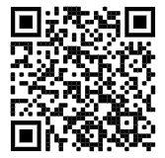
WELCOME TO NHS
Submit Hours Here
@bhsnhs23
Please sign in at the table closest to the door

Slide 2
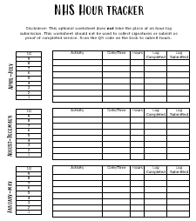
WELCOME TO NHS
Make sure to join the NHS remind @bhsnhs23
Visit our website www.brownsburgnhs.weebly.com for contact information, hour submission, meeting PowerPoints, and more
Feel free to pick up an optional hour tracker from the table closest to the door (THIS DOES NOT TAKE THE PLACE OF AN HOUR LOG)
Anna Conklin
President
Natalie Beebe
Vice President

Slide 3
MEET THE SECRETARIES
Amelia Bingaman
A-G Hours
(404) 710-2309
Sruthika Gangisetty
H-P Hours
(317) 946-4513
Emily Perkins
R-Z Hours
E.Perkins225@gmail.com
Comfort Opafola
In-Club Points
(317) 652-3980
Please contact your secretary if you are having difficulty submitting hours. Contact information is also on the NHS website under the “Hour Submission” tab

Slide 4
SECRETARIES
Summer Hours | Fall Hours | Spring Hours
10 community or school service hours Summer Hour logs are due September 1st | 10 community or school service hours 4.5 tutoring hours 5 in-club points | 10 community or school service hours 4.5 tutoring hours 5 in-club points 5 additional service hours (from any semester)

Slide 5
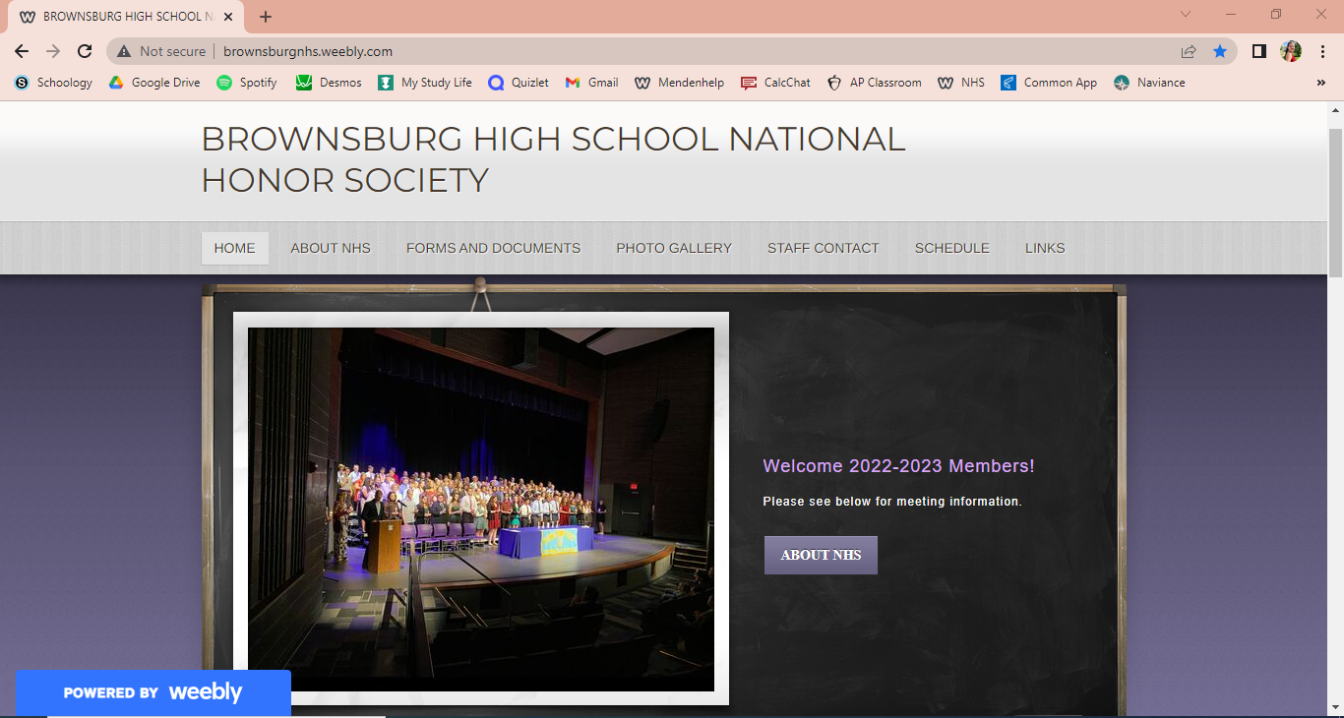
Step One: Go to brownsburgnhs.weebly.com
Step Two: Click on the “Hour Submissions” tab under the “Links” bar in the far right

Slide 6
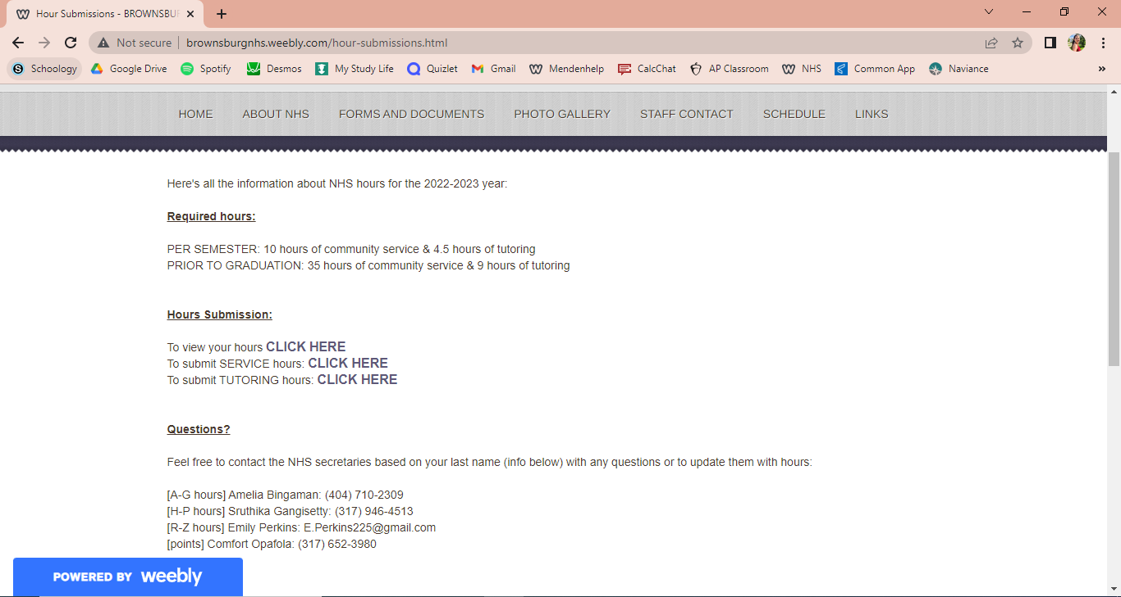
Step Three: Click the “CLICK HERE” button next to either service hours or tutoring hours, depending on the type of hours you wish to submit

Slide 7
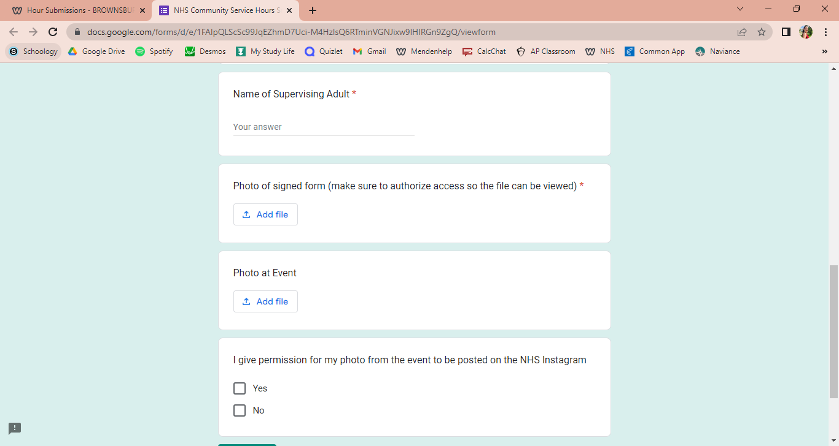
Step Four: Fill out the information in the form. At the bottom you will need to submit a picture of a signed NHS form from the event.

Slide 8
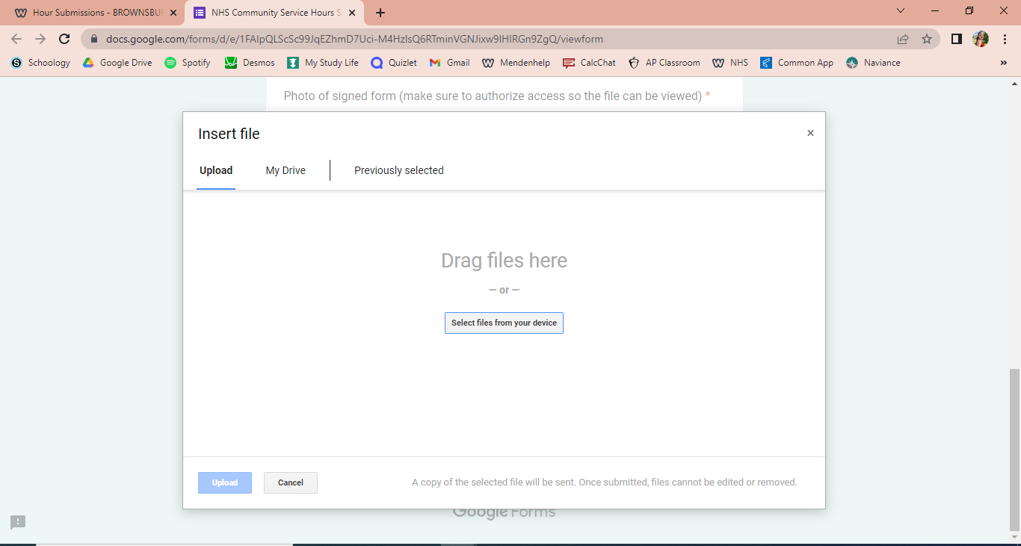
Step Five: Either upload a photo from your device or save the photo to your Google Drive.

Slide 9
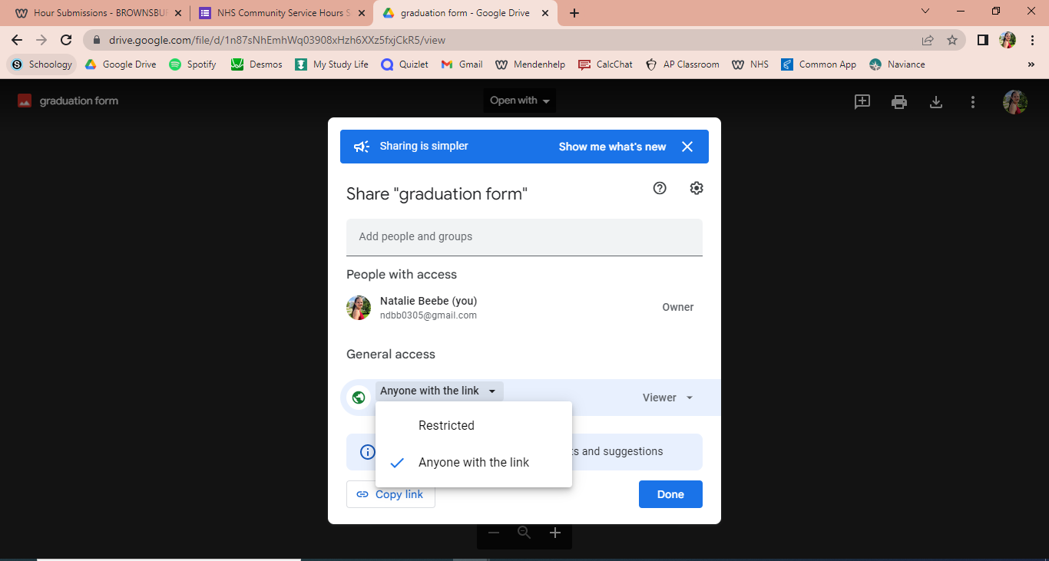
Step Six: If uploading from Google, make sure you have given the photo general access to anyone with the link. This ensures Secretaries can view the photo.

Slide 10
FUNDRAISING
Mum fundraiser began this week
$10 per mum
1 in-club point per mum sold
Mum distribution will take place on 09/16. Volunteers will earn one in-club point per hour of volunteering
Order sheets have been sent out on Remind. Extra copies are in Mrs. Walter’s room (SA301)
Cate Harrison
Committee Chair
Cecilia Opoku Committee Chair

Slide 11
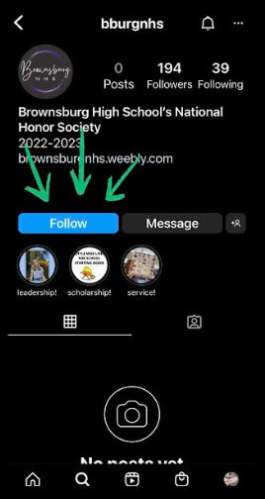
SOCIAL AND SPIRIT
Follow us on Instagram @bburgnhs for important updates and reminders
Make sure to take pictures while volunteering to have a chance to be featured and earn in-club points
Either DM photos to the NHS Instagram or text them to 317-695-8942
Note: event photos are completely optional
Grace Bay
Committee Chair
Avery Terry
Committee Chair

Slide 12
COMMUNITY
There will be two main community service projects this year
Food drive in November
Service project in Spring (TBD)
Contact community team if you have any service projects or organizations that you’d like us to be a part of by emailing hannahbailey189@gmail.com
Hannah Bailey
Committee Chair
Snit Welde Committee Chair

Slide 13
TEACHER APPRECIATION
First event will be a soda can drive to place in teacher’s lounges
Earn in-club points by donating soda cans
6 pack = 1 point
12 pack = 2 points
max of 2 points per member
Leave first and last name somewhere on pack of soda so you can earn your in-club points
Turn in cans to Mrs.Walter’s room (SA301) by 9/30
Use the sign up genius in the NHS remind to sign up to donate cans or to decorate the teacher’s lounge
Allie Riggs
Committee Chair
Ashlyn Stout
Committee Chair
Sydney Parpart
Committee Chair

