Slide 1
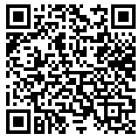
WELCOME TO NHS!
Please sign in at the front table. Check the number of hours and points you have by scanning the QR code. If you notice anything missing, please talk to one of the secretaries (Amelia, Sruthika, Emily, or Comfort)
Please take one card from the table and write 3-6 sentences thanking the teacher for all they do. When finished, put the card in the finished stack. Please sign the card “Your Name (NHS)”

Slide 2
STAY CONNECTED WITH NHS
Remind:
@bhsnhs23
Instagram:
@bburgnhs
Website:
http://brownsburgnhs.weebly.com
Important Dates
Thursday 2/23 | Meeting
Thursday 4/13 | Final Meeting
Wednesday 4/26 | ALL HOURS DUE
Thursday 4/27 | Optional Grab and Go Breakfast Celebration

Slide 3
UPCOMING OPTIONAL EVENTS
White Lick Family Fun Night
Friday 1/27
5:45-7:15
Brownsburg Parks Weed Wrangle 2/4, 2/8, 2/22, 2/25, 3/8, 3/11
1:00-3:00
**Must be accompanied by an adult if under age 18
Father Daughter Dance Friday 2/17 and Saturday 2/18
Various PM shifts
BHS Transition Fair
Tuesday 2/28
Various PM Shifts
Looking for tutoring hours? Reach out to the academic coaches via Schoology to see if there are any available opportunities.
Event sign ups and information are on the NHS Remind @bhsnhs23

Slide 4
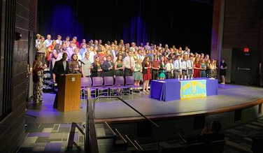
FYI- NEW MEMBERS
Our next NHS class will be inducted in early March.
New members will join us at our April 13th meeting.
If you are approached with any question about NHS that you are unsure about, please direct the student to Mrs. Mendenhall or Mrs. Walter.

Slide 5
SECRETARIES
Summer Hours | Fall Hours | Spring Hours
10 service hours | 10 service hours 4.5 tutoring hours 5 in-club points Should be completed and submitted by now. If you haven’t submitted, please do so ASAP! | 10 service hours 4.5 tutoring hours 5 in-club points 5 additional service hours (from any semester) All hours are due Wednesday, April 26th
Please make sure you are submitting hours through the hour submission links on the NHS website. You can also check your hours and points on the website. For any questions or missing hours/points, contact your secretary.
http://brownsburgnhs.weebly.com/hour-submissions.html

Slide 6
FUNDRAISING
Upcoming Fundraising Event
Thank you for all who participated in the December Bake Sale, it was a huge success!
Stay tuned for our next fundraising event. There will be an opportunity to earn service hours.

Slide 7
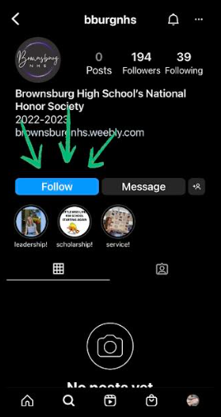
SOCIAL AND SPIRIT
Upcoming Activities
Come prepared to our February 23rd meeting with one piece of advice to write down for future NHS members.
Semester 2 breakfast is currently being planned for Thursday, April 27th. Thank you to all who participated In the December breakfast!
Make sure to DM pictures of you serving to the NHS Instagram to be featured.

Slide 8
COMMUNITY
Upcoming Service Project
There will be one more in-club service project this Semester.
Stay tuned to Remind for additional information.
Every member will have to participate in the service project.

Slide 9
TEACHER APPRECIATION
Valentine’s Day Cards
Please make sure all finished cards are put at the front table. The cards will be delivered to SA teachers within the next few weeks.

Slide 10
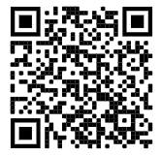
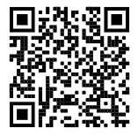
Any Questions? (Next Meeting- February 23rd)
Submit Service Hours Here
@bhsnhs23
View Hours and Points Here

