Slide 1
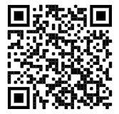
WELCOME TO NHS
Submit Service Hours Here
@bhsnhs23
Please sign in at the table closest to the door

Slide 2
WELCOME TO NHS!
NHS Meeting Dates
December 1st
(grab-and-go breakfast)
January 26th
February 23rd
April 13th
Visit our website www.brownsburgnhs.weebly.com for contact information, hour submission, meeting PowerPoints, and more
Make sure to join the NHS remind @bhsnhs23

Slide 3
UPCOMING OPTIONAL EVENTS
Festival of Trees Monday 11/21 and Saturday 12/3
Various AM and PM Shifts
BHS Madrigal Dinner Kitchen Volunteers Friday 12/8 and Saturday 12/10
4:00-9:30pm
Event sign ups and information are on the NHS Remind @bhsnhs23

Slide 4
SECRETARIES
Summer Hours | Fall Hours | Spring Hours
10 community or school service hours Should be completed and submitted by now. If you haven’t submitted, please do so ASAP! | 10 community or school service hours 4.5 tutoring hours 5 in-club points Fall Hour logs are due December 1st | 10 community or school service hours 4.5 tutoring hours 5 in-club points 5 additional service hours (from any semester)
Please make sure you are submitting hours through the hour submission links on the NHS website
http://brownsburgnhs.weebly.com/hour-submissions.html
There is a separate link for submitting tutoring hours

Slide 5
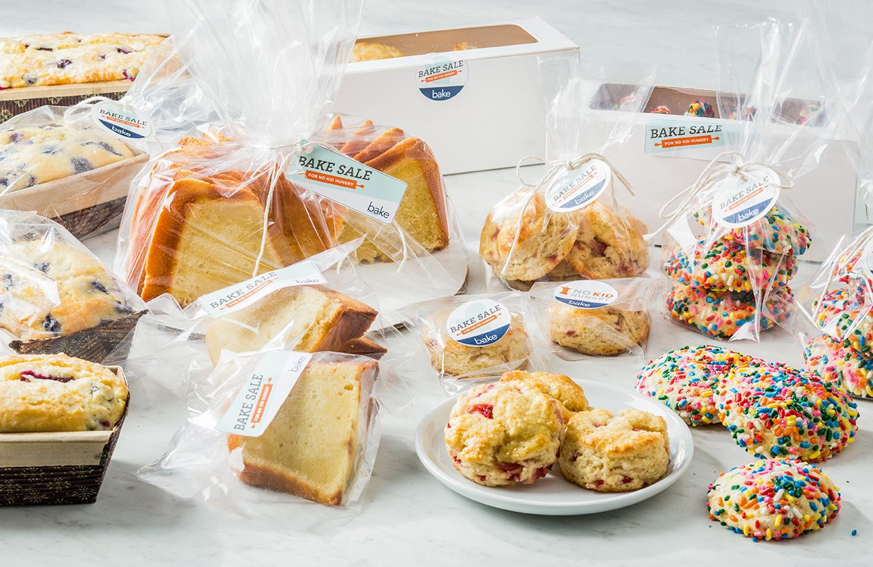
FUNDRAISING
December Bake Sale
We will be having a bake sale during the varsity basketball game on Friday, December 2nd
We are asking for members to bring in nut-free individually packaged items to be sold during the basketball game. Homemade items are allowed, but they must be individually packaged.
Suggested treats: Chocolate Chip/M&M Cookies, Rice Krispy Treats, Sugar Cookies, Brownies, Muffins, Chocolate or Vanilla Cupcakes
There will be a sign up genius posted on the NHS remind within the next few weeks to sign up to bring in treats

Slide 7
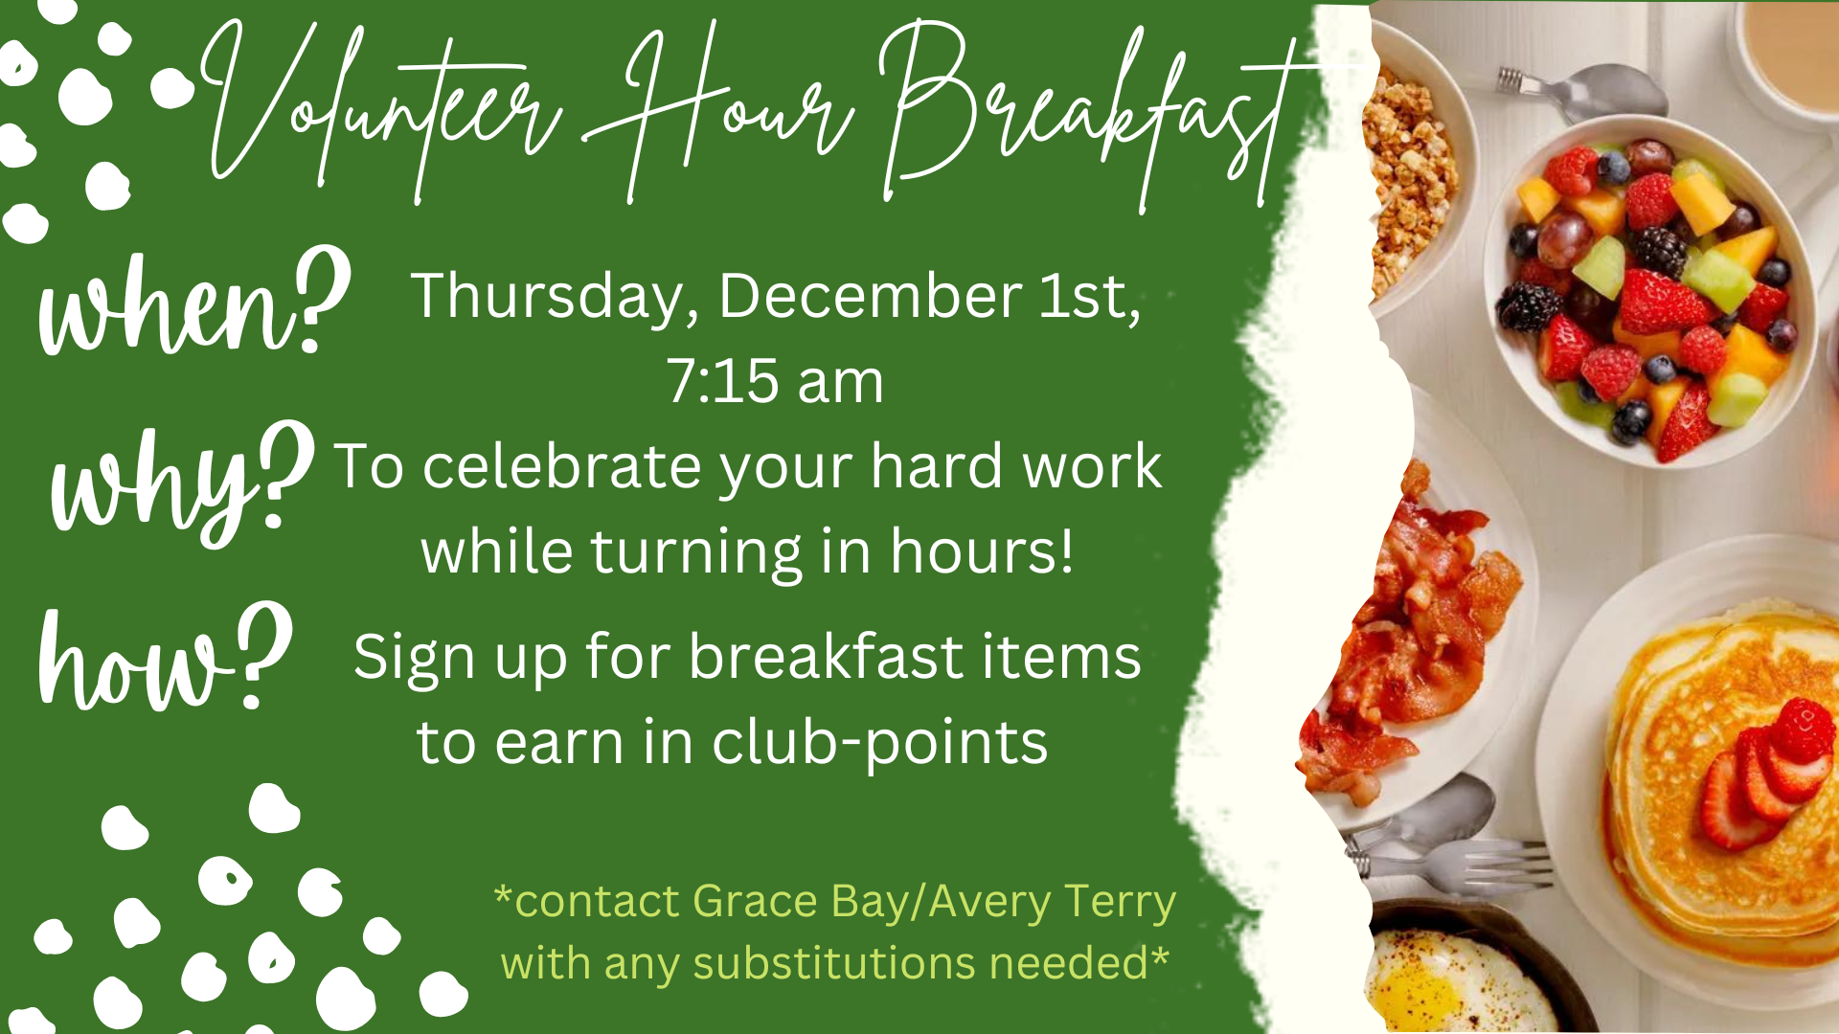

Slide 8
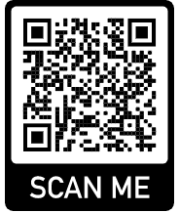
Food items can be brought in from November 7th to November 15th
Every NHS member is required to bring in two items. You will receive a paper TODAY that your first period teacher will sign to verify that you brought in your two cans.
We will need 8-10 volunteers every morning to help collect cans. You can earn one in-club point by volunteering each morning. Sign up using the QR code below.
For every five additional cans you bring in, you will receive one in-club point
Club Service Project: Food Drive

Slide 9
TEACHER APPRECIATION
Soda Can Drive - Thank you!!
Thank you to everyone who brought in cans for the soda can drive
Your in-club points from bringing in cans should be updated within the next few days
Stay tuned for upcoming teacher appreciation projects

Slide 10
Any Questions? (Next meeting - January 26)
Submit Service Hours Here
@bhsnhs23
Food Drive AM Help Sign-Up

